Slide 1
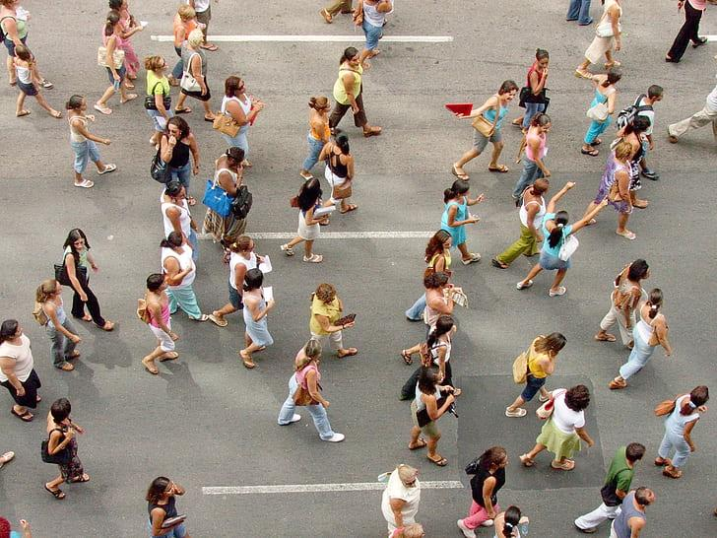
People-First Cities
Cities designed for people, not cars (or scooters)
1133547 Asiah Crutchfield/孫賽亞 | 1133571 Akmal

Slide 2
SDG 11: Sustainable Cities and Communities
Make cities inclusive, safe, resilient, sustainable, and more enjoyable to live in.
Why It Matters
🌆 Over half the world’s population lives in cities — and growing.
🚗 Cities produce 70% of global carbon emissions, much from transport.
🚌 Sustainable mobility improves air quality, accessibility, and quality of life.

Slide 3
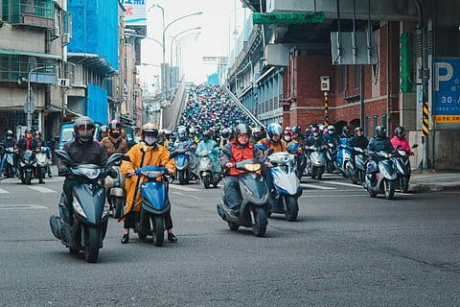
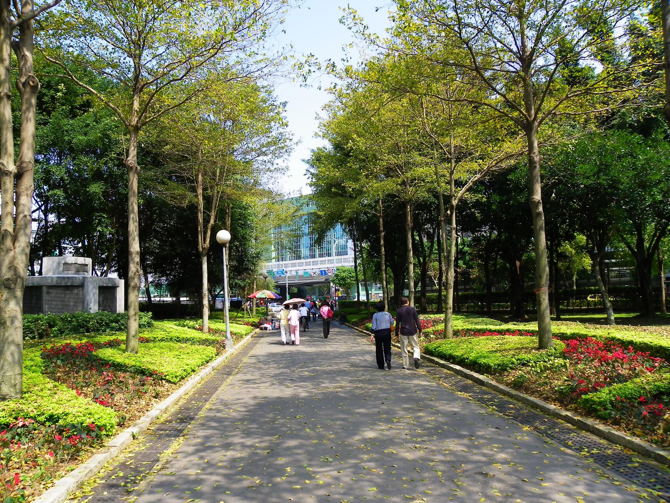

Slide 4
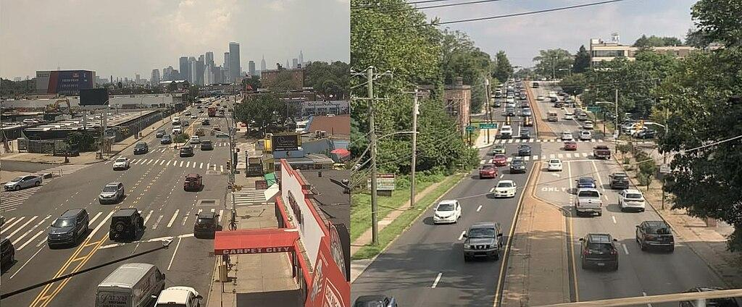
Current problems
Taiwan | US
🚶‍♀️ Poor sidewalks – In smaller cities, walking can be unsafe or unpleasant. | 🚘 Car dependency – Most cities built for cars, not people.
🌫️ Air & noise pollution – From dense scooter traffic. | 🚶‍♂️ Low walkability – Many neighborhoods lack sidewalks or crosswalks.
 | 🚌 Weak public transport – Buses are infrequent, rail is limited, and coverage is poor.
 | 🌫️ High emissions – From long car commutes and urban sprawl.

Slide 5
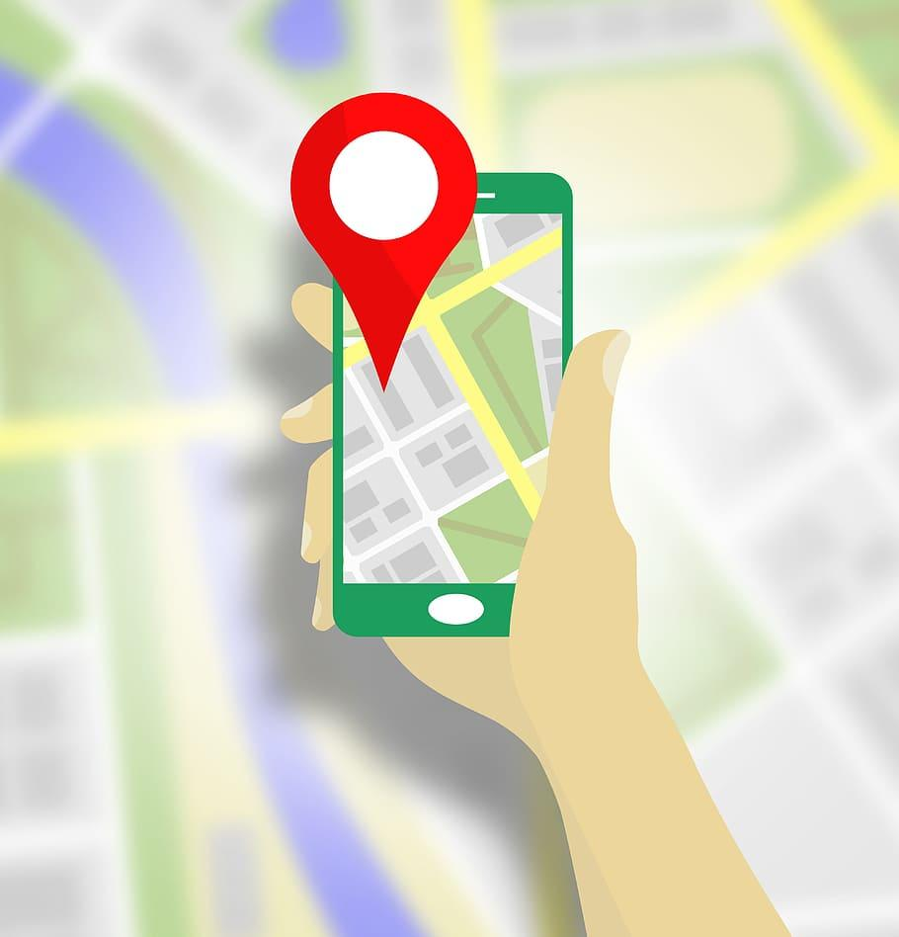
Making the Most of Today
Features that are people-first:
Route finder (walking, biking, public transport): prioritizes sustainable methods in a hierarchy going from walking ➡️ cycling ➡️ public transport ➡️ rideshare ➡️ personal vehicle
Scenic suggestions: includes user-submitted route suggestions for safest and/or most scenic walking and cycling routes
Alerts: Alerts for unsafe areas
Tips for commuters in areas that are not practical for walking or biking

Slide 6
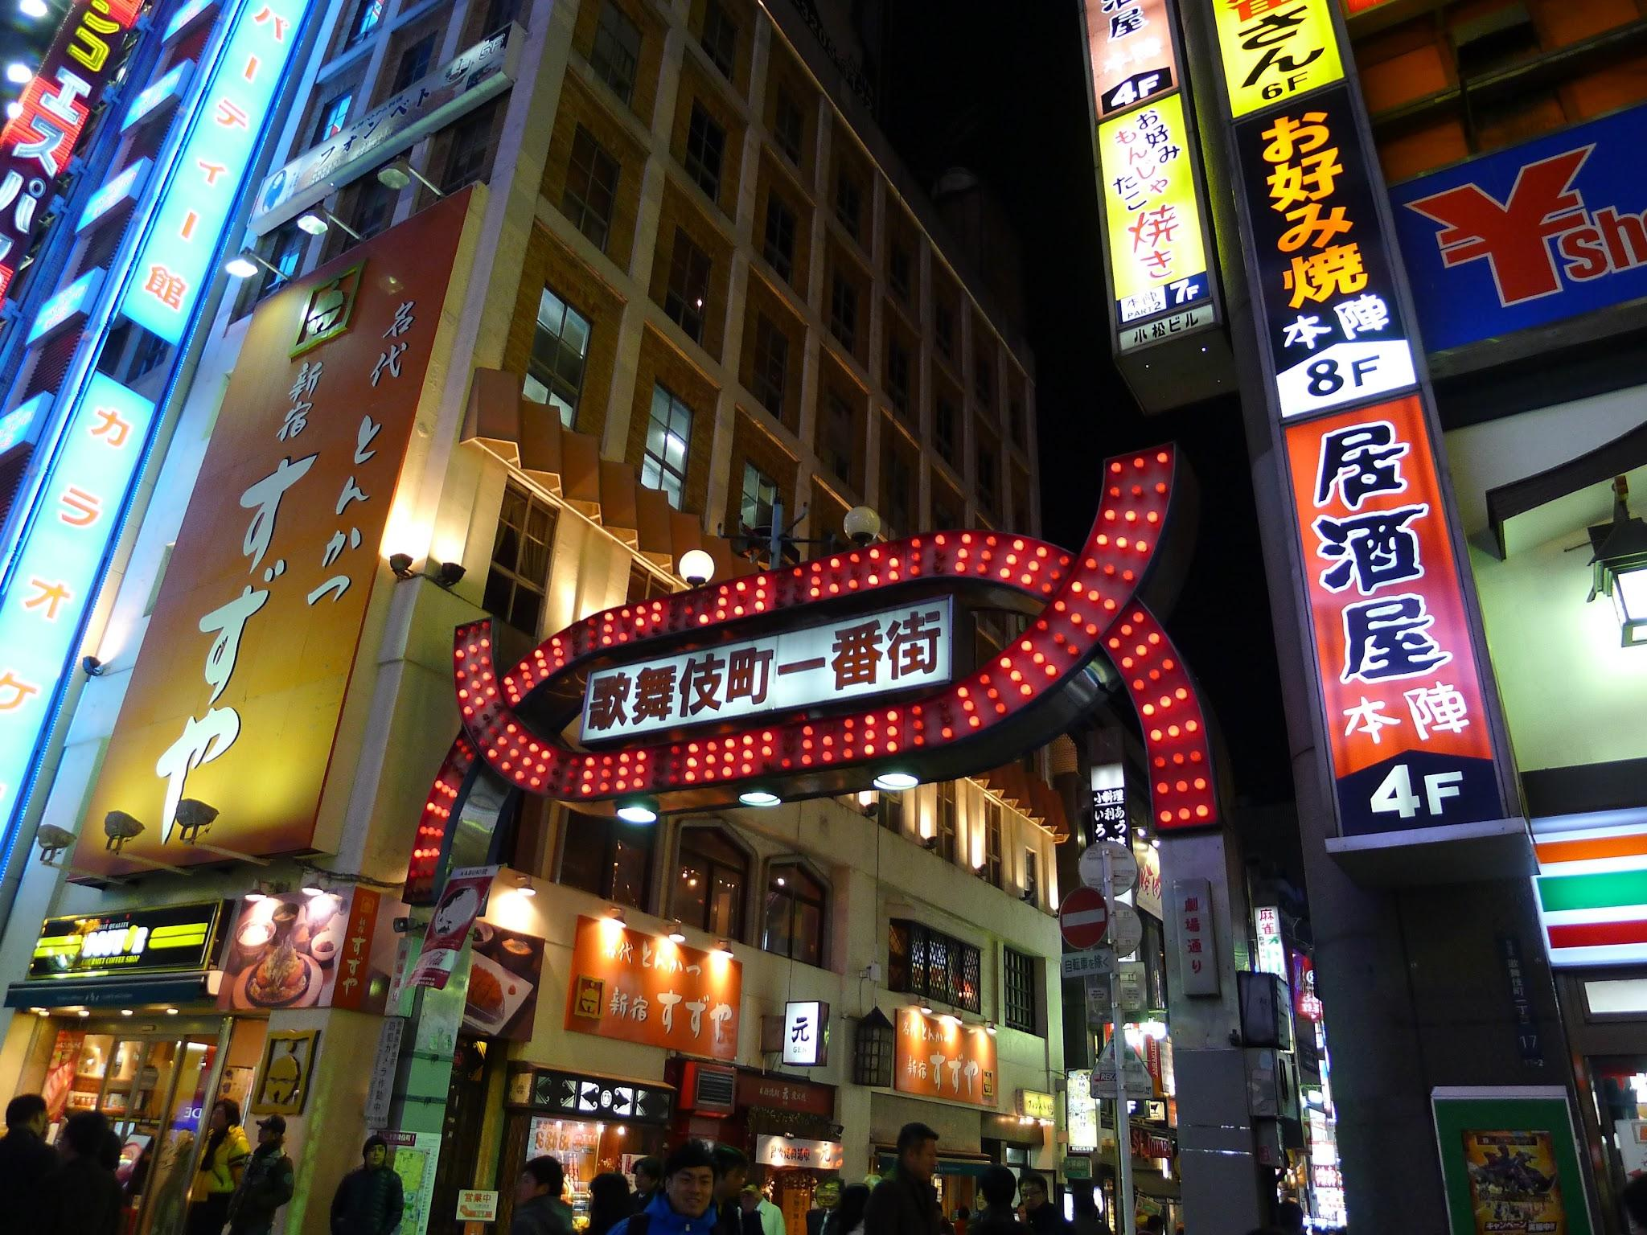
Promote better cities
Suggestions on how to improve Taiwan using examples from other successful cities such as Amsterdam or Tokyo.
Better sidewalks and bike lanes outside major cities
Electric buses / expanded rail networks
Safer scooter integration
Traffic enforcement

Slide 7
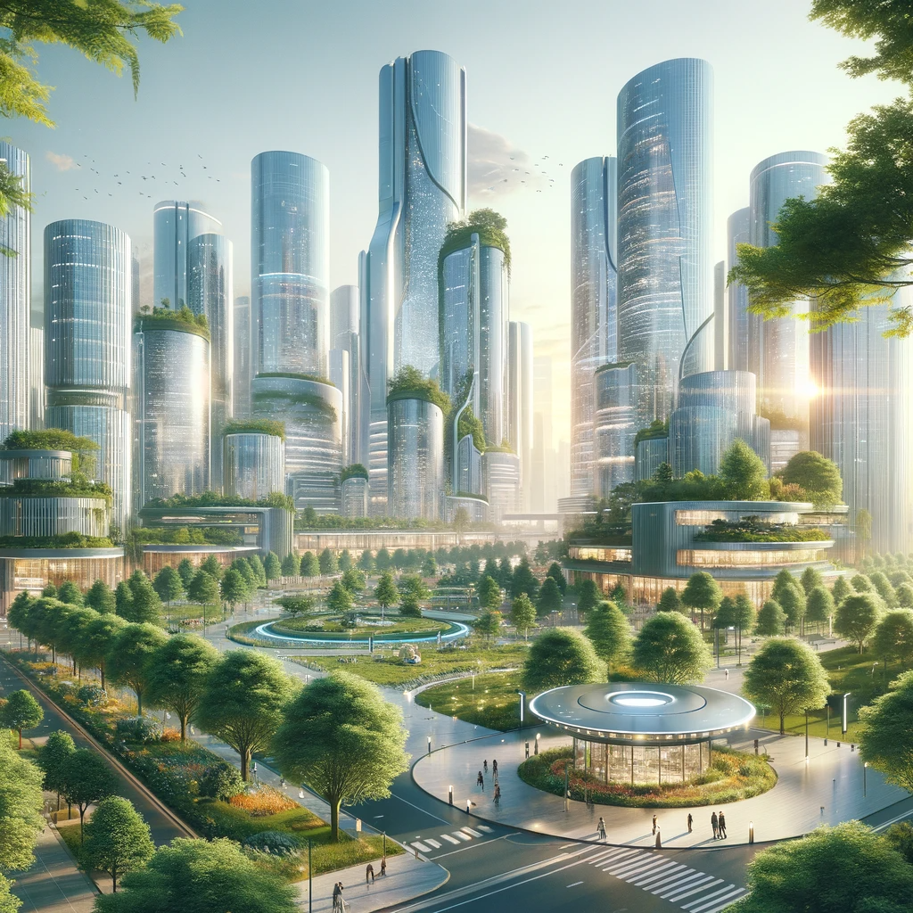
Thank you

